Slide 2
Leaving A legacy

Slide 3
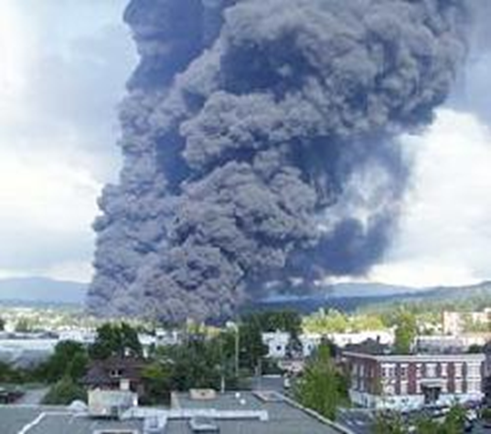
Bellingham Pipeline disaster Damaged in 1994 - Explosion 1999
Excavator Failed to call/Maintain locates
Supposed to only dig with a pipeline spotter
Damaged pipe
Failed to notify Olympic pipeline of damage
Killed 3 people

Slide 4
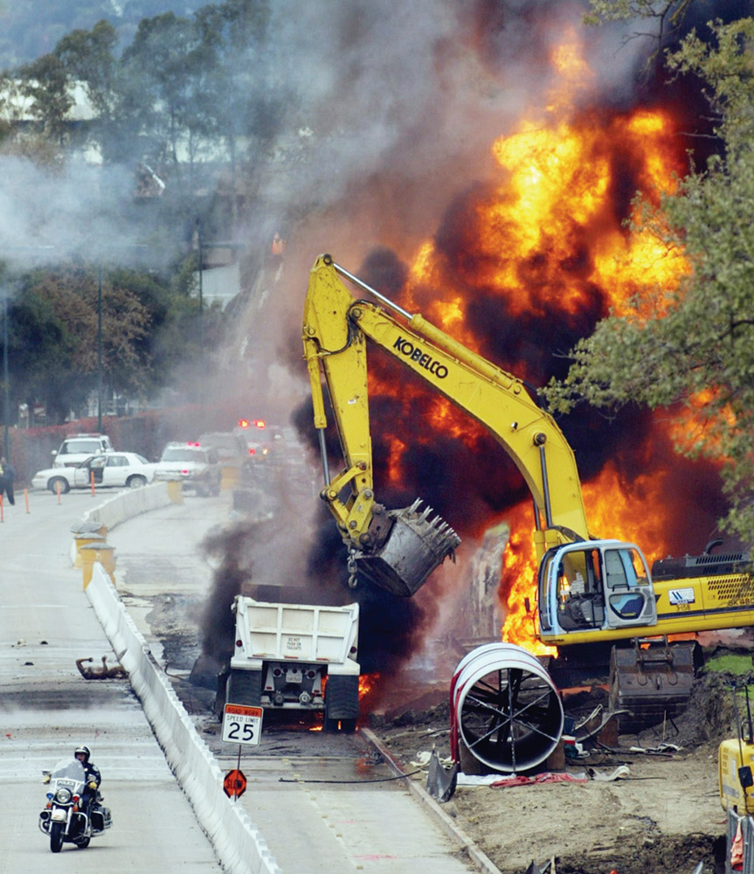
Walnut Creek California
5 people died
Inaccurate locates
6 felony charges
Fined $15,000,000
Legal settlements-
$90,000,000

Slide 8
Purpose of the Safety committee
Education
prevent damage to underground utilities
Worker safety
Public safety
Review complaints alleging violations of RCW 19.122 related to locating and excavation around underground facilities.
Recommend penalties and action to the UTC

Slide 9
Why NUCA?
Raising the bar
Bettering the industry as a whole
Advocacy
Contractor involvement

Slide 10
How can we raise the contractor standard?
Education
Peer pressure
Insurance industry
?

Slide 11
Peer Pressure
We need times and places to get together
Bid pressure
Mutual respect

Slide 12
Advocacy
Cogent and coherent…. Lol
Not just about getting more funding
Working together

Slide 13
Contractor involvement
That is the question!

