Slide 1
Gas Facility Replacement Program aka Aldyl A Pipe Replacement Program Main Pipe Replacement & Service Tee Transition Rebuilds (STTR)
2016 NWUCC JOINT STATES MEETING September 29, 2016

Slide 2
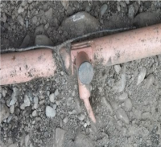
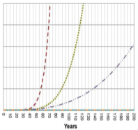
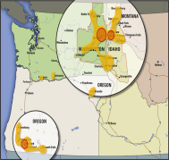
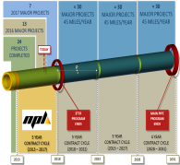
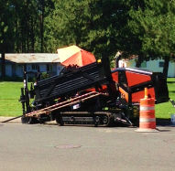
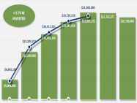
OVERVIEW
WHAT
WHY
WHERE
WHEN
HOW
RESULTS
MANAGING
THE ASSETS
DIMP & PRIORITIZATION
SCOPE & REACH
20 YEAR PLAN & MILESTONES
CONSTRUCTIONMETHODS
PERFORMANCE
& COSTS
CUSTOMER CARE
Notes:
CONSTRUCTION, LEVERAGING TECHNOLOGY & COST CONTROL

Slide 3
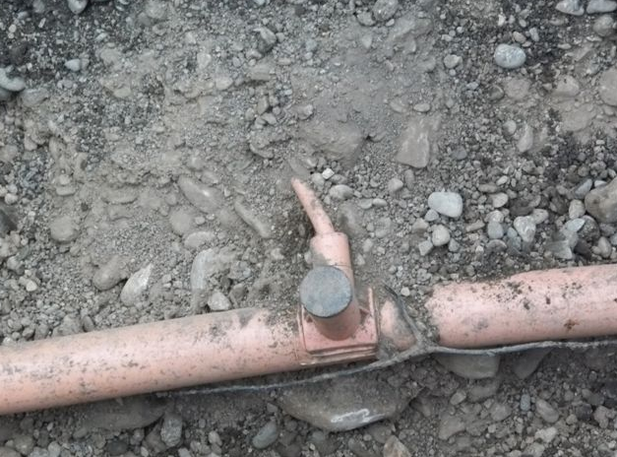
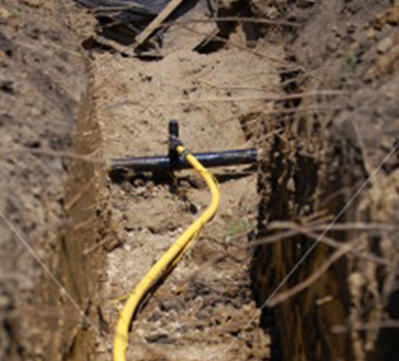
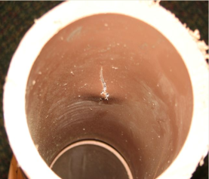
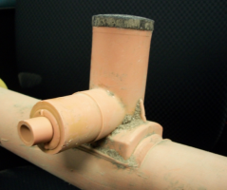
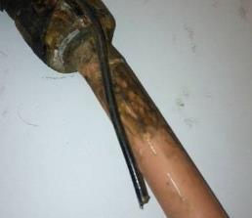
MANAGING THE ASSETS
MAIN PIPE
1 ¼” TO 4” DIAMETER PIPE
INSTALLED 1964 TO 1987
REPLACEMENT OF MAIN PIPE & SERVICE TOWERS
SERVICE TEE TRANSITION REBUILD (STTR)
ALDYL A SERVICE PIPE AT STEEL TEE LOCATED ON STEEL MAIN
MAIN PIPE & PRIORITY SERVICES
Notes:
WHAT – Managing the Assets
PROACTIVE PROGRAM DESIGNED TO:
737 MILES OF MAIN PIPE AT START OF THE PROGRAM
NEARLY 18,000 STTRS AT START OF PROGRAM

Slide 4
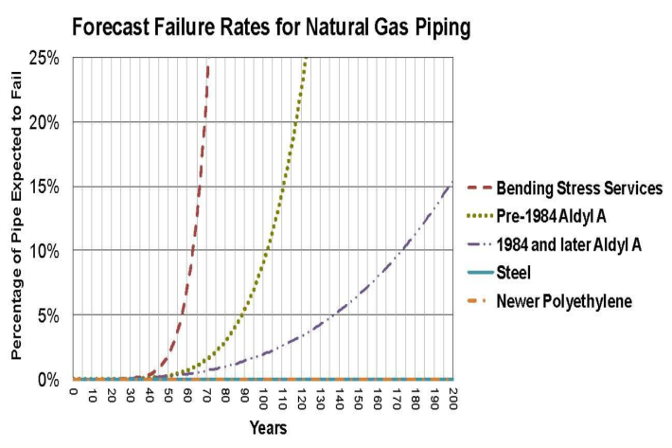
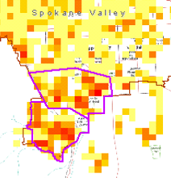
ASSET MANAGEMENT ANALYSIS – DIMP & PRIORITIZATION
PROTOCOL FOR MANAGING ALDYL ‘A’ PIPE
AVISTA ASSET MANAGEMENT
(FEBRUARY 2012)
20 YEAR TIME FRAME IS OPTIMUM
DISTRIBUTION INTEGRITY MANAGEMENT PLAN (DIMP)
KNOW WHAT IS IN YOUR SYSTEM
IDENTIFY THREATS
EVALUATE & RANK RISKS
IDENTIFY & IMPLEMENT MEASURES TO REDUCE RISK
MEASURE / MONITOR & EVALUATE EFFECTIVENESS
REPORT RESULTS
TOP 29 PROJECT AREAS GEOSPATIALLY LOCATED IN GIS USING RISK DATA
LEAK SURVEYS CONTINUE TO CAPTURE NEW DATA & IDENTIFY THREATS
Notes:
WHY – Asset Management analysis shows the failure rates & indicates:
20 YEAR TIME FRAME IS OPTIMUM TO MANAGE MAIN PIPE RISK & SPEND
DIMP – Federally Mandated in 2011

Slide 5
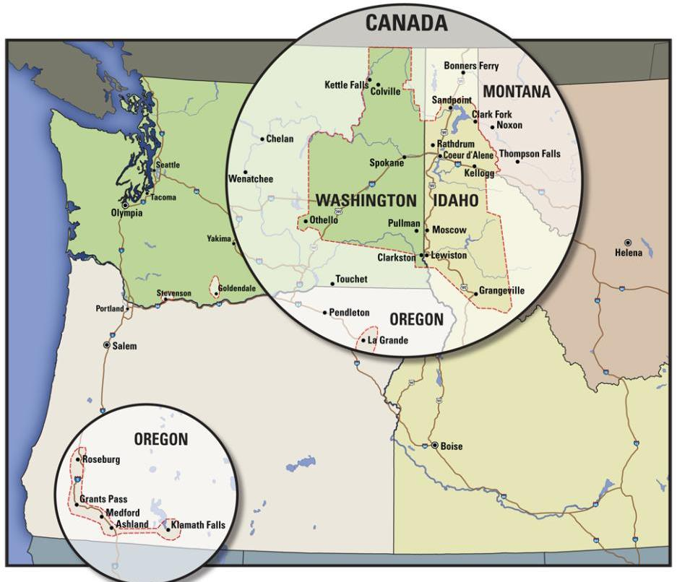
SCOPE & REACH
= DENSE QUANTITY
= LOWER QUANTITY
Notes:
WHERE IT IS
MAIN PIPE 737 MILES (20 YEARS)
STTR’S 17,769 (5 YEARS)
5

Slide 6
2016 MAJOR PROJECTS
COLVILLE/CHEWELAH STTR (229)
2016 OVERVIEW
DEER PARK STTR (66)
FAIRWOOD E. MAIN PIPE (4.14 MI)
SCOPE
N. SPOKANE MAIN PIPE (5.56 MI)
MAIN PIPE:
24.73 MILES
SPOKANE S.H. & ADJ. STTR (770)
STTR’S:
≈ 3,385 UNITS
KELLOGG & ADJ. STTR (197)
PULLMAN & ADJ. STTR (419)
13 MAJOR PROJECTS
MOSCOW & ADJ. STTR (316)
39 MUNICIPAL JURISDICTIONS
GENESSE, ID (5.46 MI)
CLARKSTON & ADJ. STTR (388)
EAST MEDFORD MAIN PIPE (4.59 MI)
KLAMATH FALLS MAIN PIPE (4.98. MI)
KLAMATH FALLS STTR (≈1,000 UNITS)
Notes:
WHERE – Aldyl A is throughout our system. This is what 2016 looks like – As you can see we are spread out across much of our territory
In future years we be even more spread out since we will have worked through the densely concentrated neighborhoods.
Currently our contractor NPL employs approximately 130-150 (170 total) people and the GFRP Team is 11. That is a >12:1 Ratio of NPL to Avista
6

Slide 7
PROGRAM MILESTONES
7
2017 MAJOR PROJECTS
≈ 30
MAJOR PROJECTS
45 MILES/YEAR
≈ 30
MAJOR PROJECTS
45 MILES/YEAR
≈ 30
MAJOR PROJECTS
45 MILES/YEAR
13
2016 MAJOR PROJECTS
24
PROJECTS COMPLETED
TODAY
4 YEAR CONTRACT CYCLE
(2028 – 2031)
5 YEAR CONTRACT CYCLE
(2018 – 2022)
5 YEAR CONTRACT CYCLE
(2013 – 2027)
5 YEAR CONTRACT CYCLE
(2013 – 2017)
STTR PROGRAM ENDS
MAIN PIPE PROGRAM ENDS
2013
2018
2023
2028
2031
Notes:
WHEN = Milestones
7

Slide 8
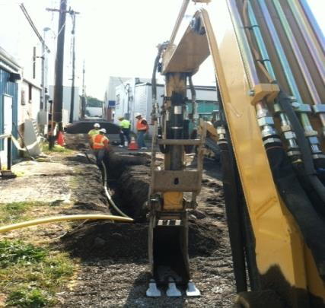
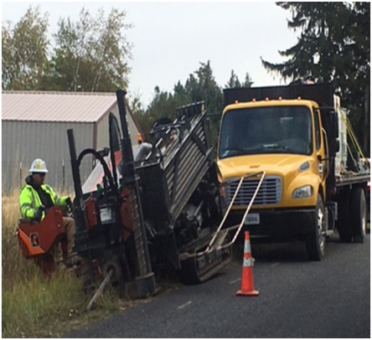
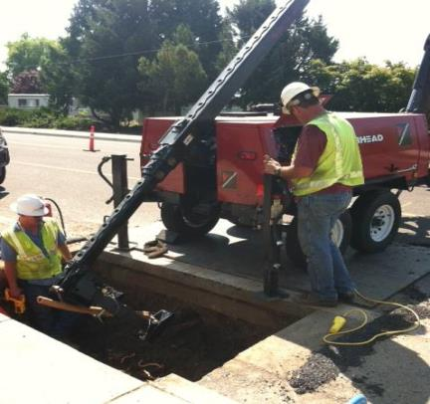
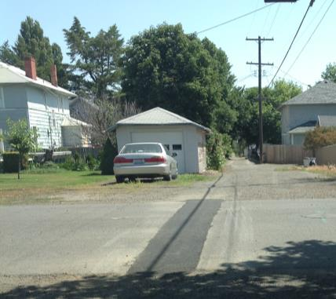
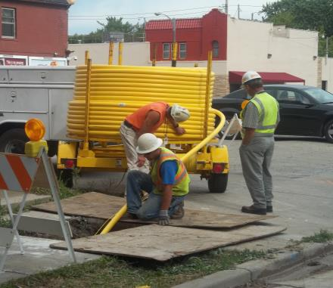
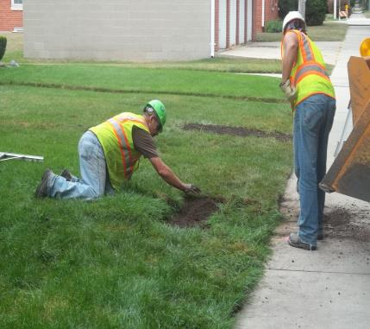
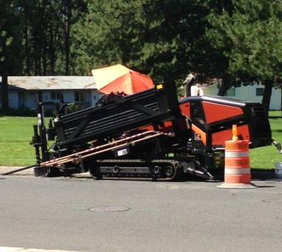
LEVERAGING TECHNOLOGY- MAJOR MAIN PIPE PROJECTS
OPEN TRENCH EXCAVATION
HORIZONTAL DIRECTIONAL DRILL (HDD)
SPLIT & PULL
GREATEST FOOTPRINT
MINIMAL FOOTPRINT
MINIMAL FOOTPRINT
Notes:
HOW
8

Slide 9
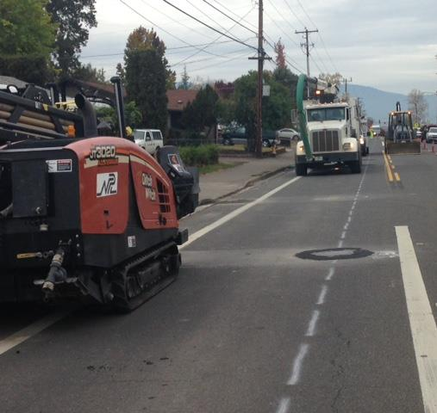
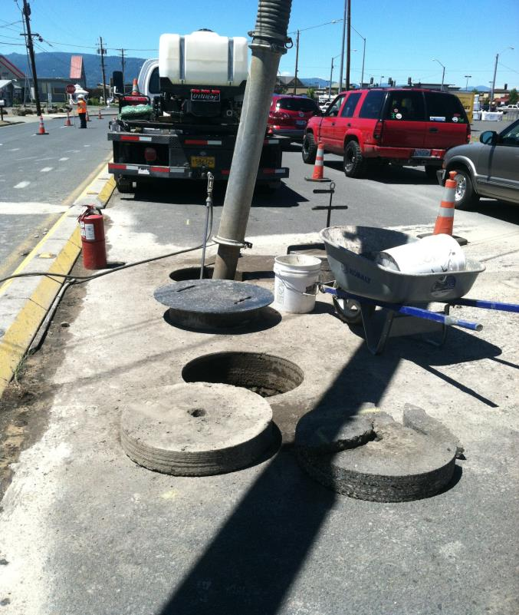
KEYHOLE TECHNOLOGY & MAIN PIPE PROJECTS
KEYHOLE TECHNOLOGY
SOFT EXCAVATION
SUPPORTS MAIN PIPE HDD/BORE OPERATIONS
SPOTTING CROSSING UTILITIES SAFELY
Notes:
HOW
9

Slide 10
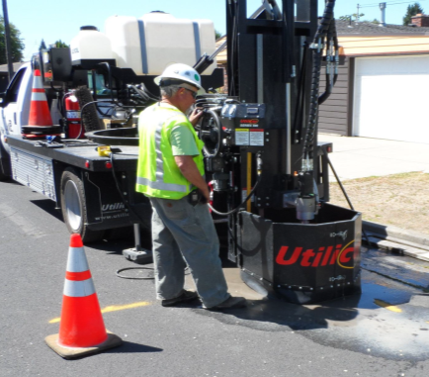
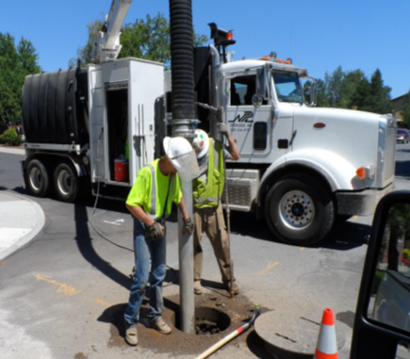
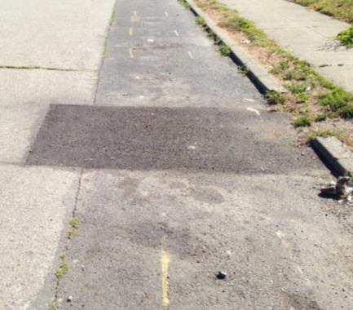
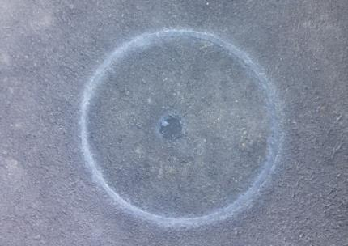
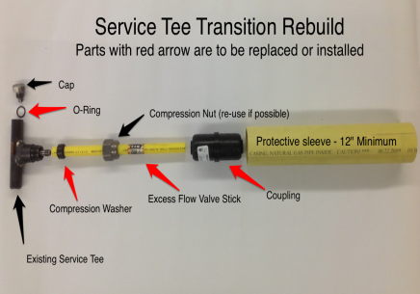
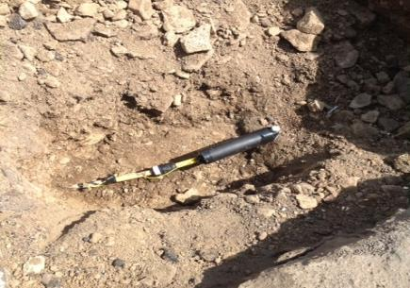
LEVERAGING TECHNOLOGY (STTR)
URBAN MICRO-SURGERY
SAFE EXCAVATION
GREATEST DISTURBANCE
KEYHOLE TECHNOLOGY
VACUUM EXCAVATION
HARD SURFACE CUT & PATCH
RE-INSTATED CORE
REBUILD ASSEMBLY
SOFT SURFACE BELL HOLE
Notes:
HOW
10

Slide 11
LEVERAGING TECHNOLOGY – 2015 RESULTS
Notes:
HOW
2014 AVERAGE FOR MAIN PIPE WAS:
HDD/BORE -
SPLIT & PULL -
OPEN TRENCH -
11

Slide 12
MAIN PIPE - SYSTEM WIDE RESULTS 2012 – AUG. 2016
Notes:
RESULTS – SCOPE – WE CONTINUE TO STAY AHEAD OF THE QUANTITIES THAT WE STATE TO THE COMMISSIONS
DELTA BETWEEN 2012-2015 TOTALS SHOWN IN BAR CHART & 82.5 IN PIE CHART IS THE 2011 ODESSA PROJECT.
STAYING AHEAD OF UTITLIY COMMISSION COMMITMENTS
12

Slide 13
STTR - SYSTEM WIDE RESULTS 2012 – AUG 2016
Notes:
RESULTS – SCOPE -
36.76 MILES OF MAIN PIPE REMAIN OF THE ORIGINALLY PLANNED 57.64 MILES BUT WE HAVE INCREASED THE MILES BY XX TO 48.16 MILES WITH 11.4 MILES OVER 2016-2017
THIS INCREASE IS TO COMPENSATE FOR THE REDUCTION IN STTRS OF APPROX. XXXX UNITS
NEED TO ADD ALL PAPER FIELDED UNITS
13

Slide 14
PROGRAM BUDGET RESULTS 2012 – AUG 2016
≈ $ 75 M
INVESTED
2012 - 2016
2012 2013 2014 2015 2016 2017 2018
Notes:
RESULTS – BUDGET - Here is the Capital Spend (Plan to Actual) results – with the budget variance by (%) percent shown at the bottom
THE GFRP REPRESENTS 5% OF AVISTA’S ANNUAL CAPITAL BUDGET
14

Slide 15
CUSTOMER CARE - COMMUNICATION
PRE-CONSTRUCTION PHASE
MUNICIPAL ROAD PROJECT COORDINATION
PERMIT COORDINATION
TOWN HALL MEETINGS
INTERNAL COORDINATION
CUSTOMER
LETTERS
PHONE
CALLS
PERSONAL
CONTACT
DOOR
HANGERS
RE-LIGHT
APPLIANCE
CONSTRUCTION PHASE
WEB
PAGE
Notes:
CUSTOMER CARE
WE COME TO THESE AREAS UNINVITED AND CREATE A LOT OF DISRUPTION IN THE ROADWAYS, AND EVEN CUSTOMER YARDS/DRIVEWAYS, ETC. WE COORDINATE WITH CUSTOMERS TO AND ENTER MOST HOMES TO RE-LIGHT APPLIANCES. DESPITE THE LEVEL OF DISRUPTION & INCONVENIENCE, THROUGH A WELL THOUGHT OUT COMMUNICATION PLAN, WE HAVE BEEN ABLE TO MINIMIZE CUSTOMER DISATISFACTION AND COMPLAINTS.
Customer Communication is a crucial component of the program and the projects. We utilize a communication tool –kit which is tailored to each project. Generally, the tool kit includes the items represented above.

Slide 16
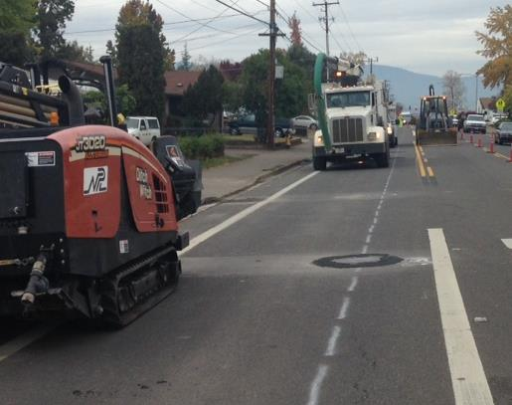
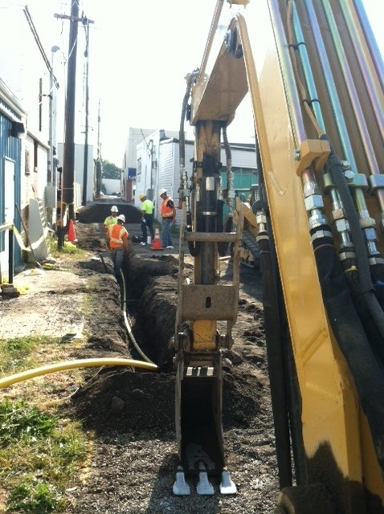
CUSTOMER CARE
Notes:
CUSTOMER CARE
2014 COMPLAINTS = < 1% AT .12 OF A %
2015 WAS EVEN BETTER WITH = < 1% AT .08 OF A %
2016 OF 13,247 PEOPLE (6,566 CUSTOMERS / 6,771 NEIGHBORING PROPERTIES) CONTACTED ONLY 5 COMPLAINTS HAVE BEEN LOGGED IN 2016
16

Slide 17
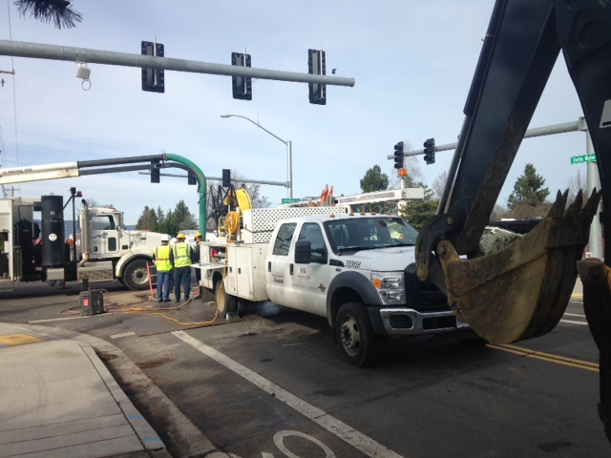
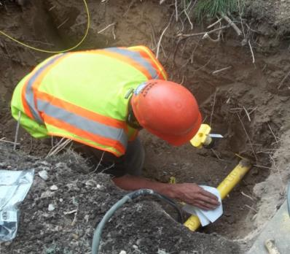
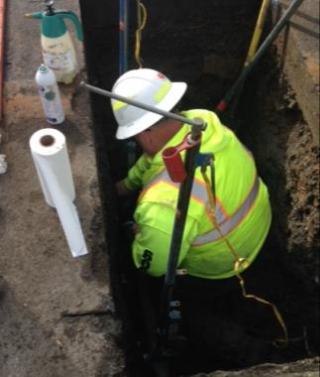
Q & A

