Slide 1
Call Before You Design
Kasey Ketterling, PE

Slide 2
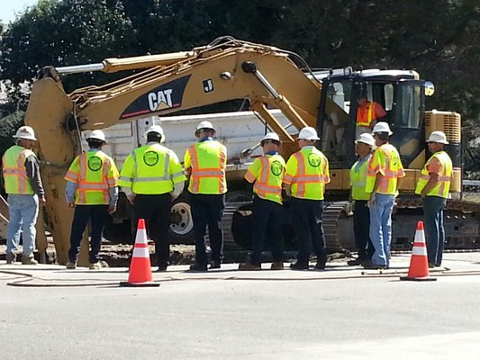

Slide 3
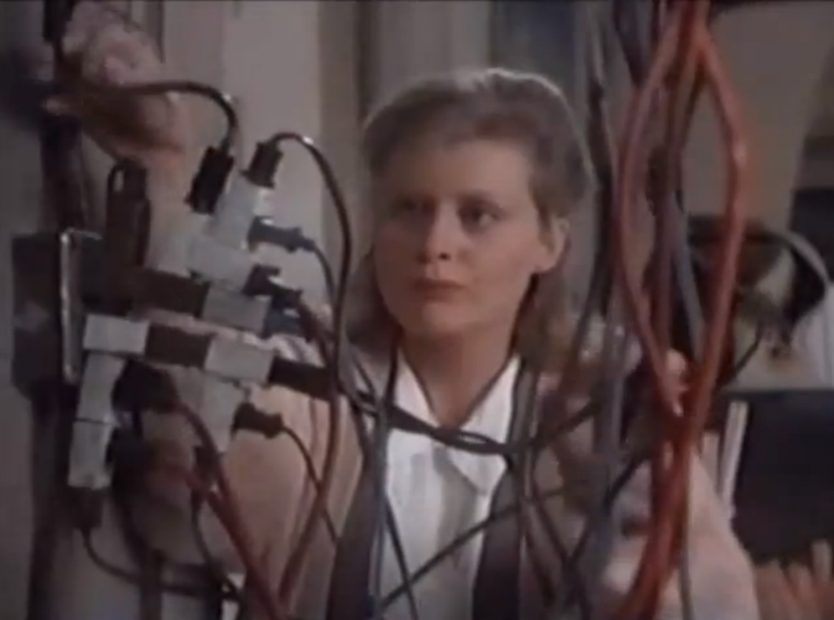

Slide 8
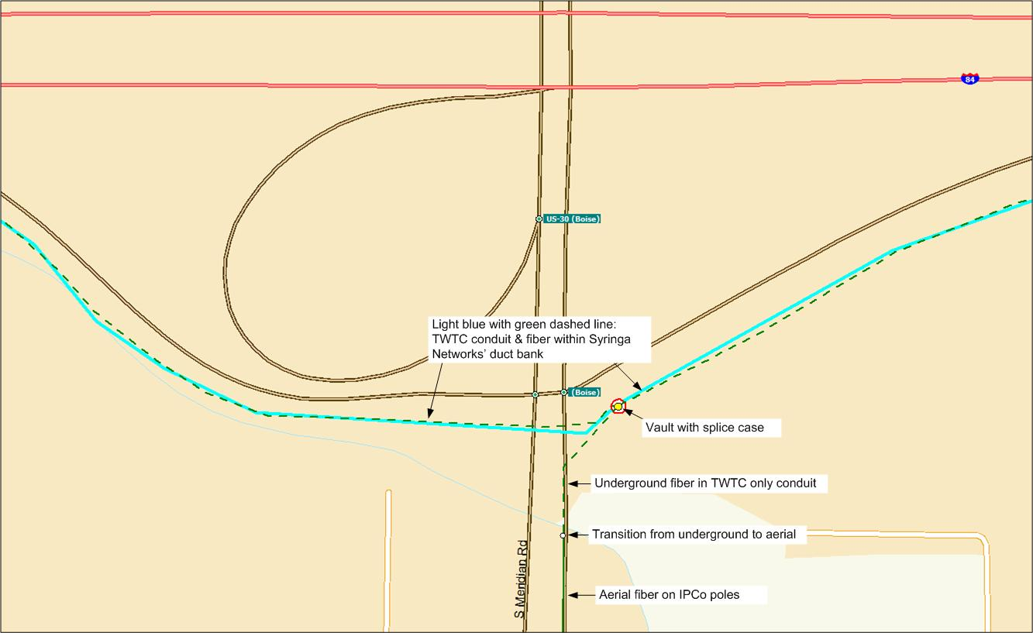

Slide 10
Utility Coordination Guidelines for Engineers
Define the limits of the project and potential impacted areas for underground utilities.
Call 811. Complete a “Facilities Map Request”. Explain you project. Request list of utilities and contacts in that area.
Send out an email to each of the utilities in that area requesting maps of their facilities.
Create a utility base map showing all utilities in the area and showing any possible conflicts with the project.
Send this map out early to utility companies to verify existing locations.
Send out 50% plans to utility companies to show relocation options/receive feedback.

Slide 11
Utility Coordination Guidelines for Engineers (con’t)
Attend a local UCC meeting to discuss the project.
Coordinate closely with utilities that will be relocated/impacted. Keep a log of conversations in case of turn over at utility or in project personnel.
Send out 100% plans to utility companies and invite them to pre-construction meeting.
At pre-con, confirm contractor’s and utility’s schedules work with each other.
If possible, coordinate throughout construction with utility companies.

Slide 12
Tips
Go to the site early
Often evidence is visible on the ground to suggest utilities in the area.
2. Keep a log of conversations
Doesn’t have to be much, just date time, and main conversation points.
I use an excel spreadsheet for each project to do this.
Great way to get someone up-to-speed if there is turnover in the utility agency or project personnel.
3. Make plans easy to read (as much as possible).
For smaller projects, assign each utility its own color.
For larger projects, assign each facility a line and a number (each pole for Idaho Power would be assigned a number: IP-101, etc.

Slide 13
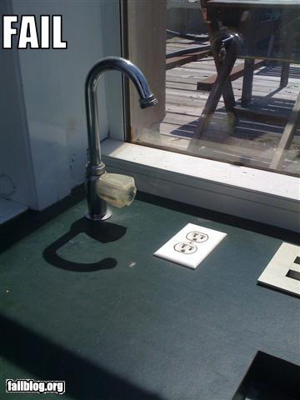
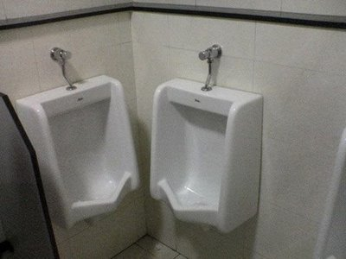
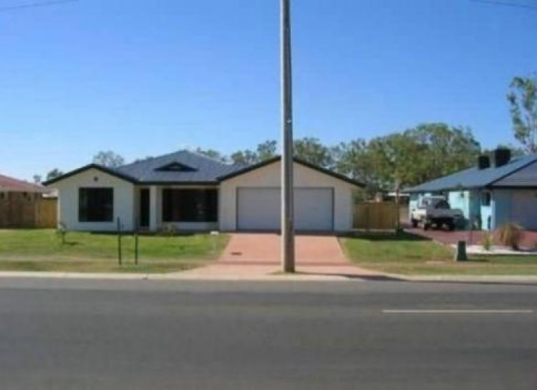

Slide 14
Suggestions
To improve Pre Design
1. Require full participation from companies
2. Mapping instead
3. Develop a “pay” system
4. Discontinue

Slide 15
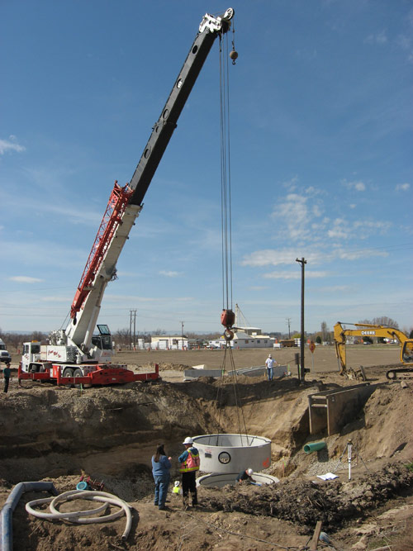
DISCUSSION

Slide 16
Thank you
Kasey Ketterling, PE
442-6300
kketterling@to-engineers.com

