Slide 1
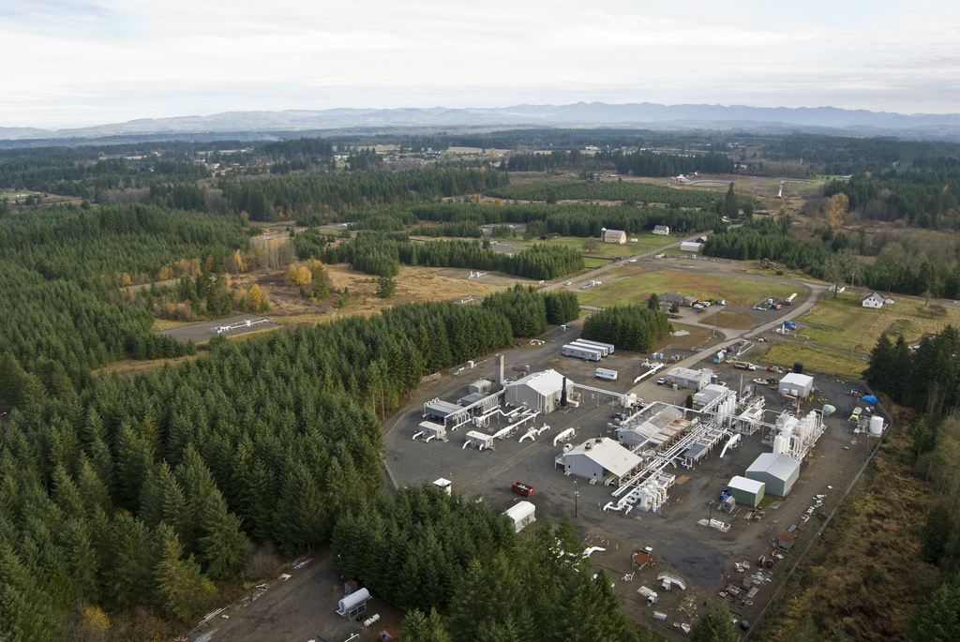
Underground Natural Gas Storage
Presented to: The Joint States Meeting, September 2016
Presented by: J. Morehouse

Slide 2
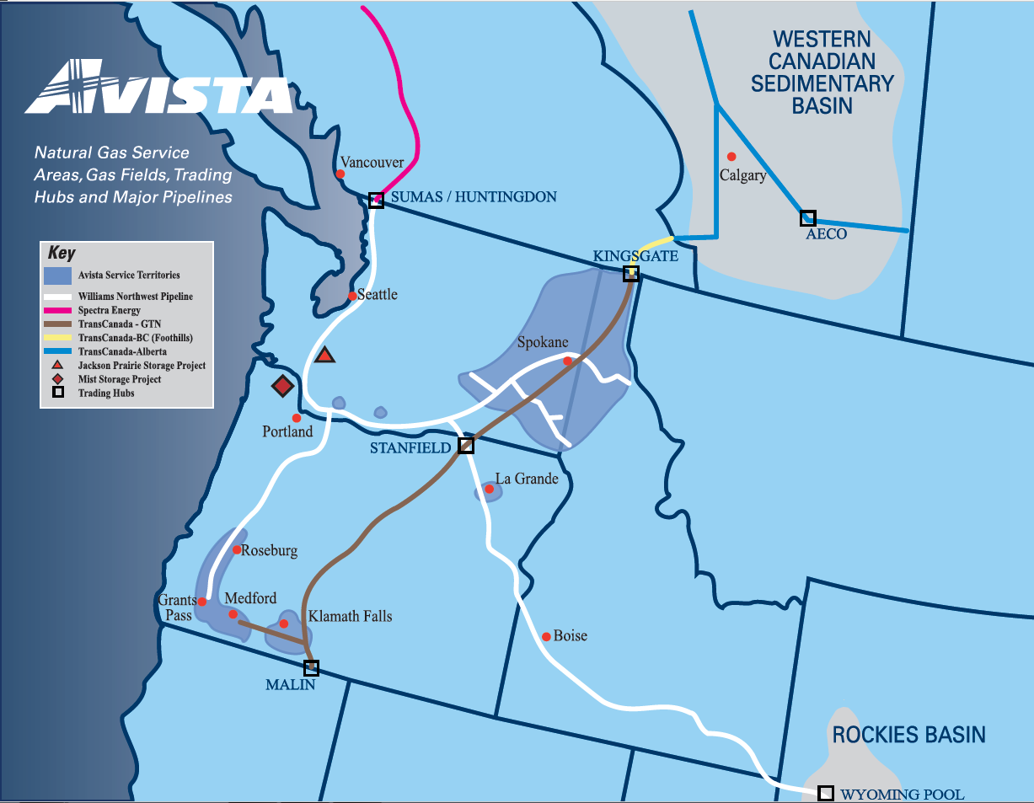
Major Pipelines
Service Territory
Covers 30,000 square miles, population of 1.6 million
Customers*
375,000 electric
334,000 natural gas
2

Slide 3
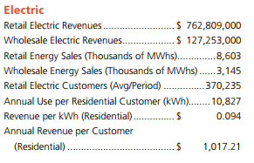
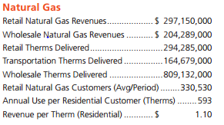

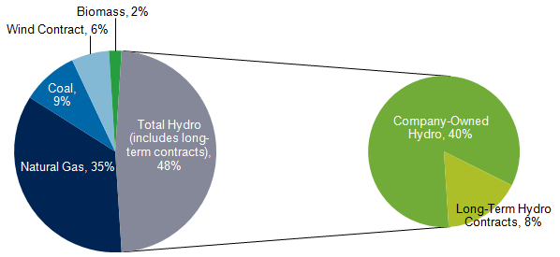
2016 Quick Facts
3
Notes:
1.3 B therms/year, 130 T btus

Slide 4
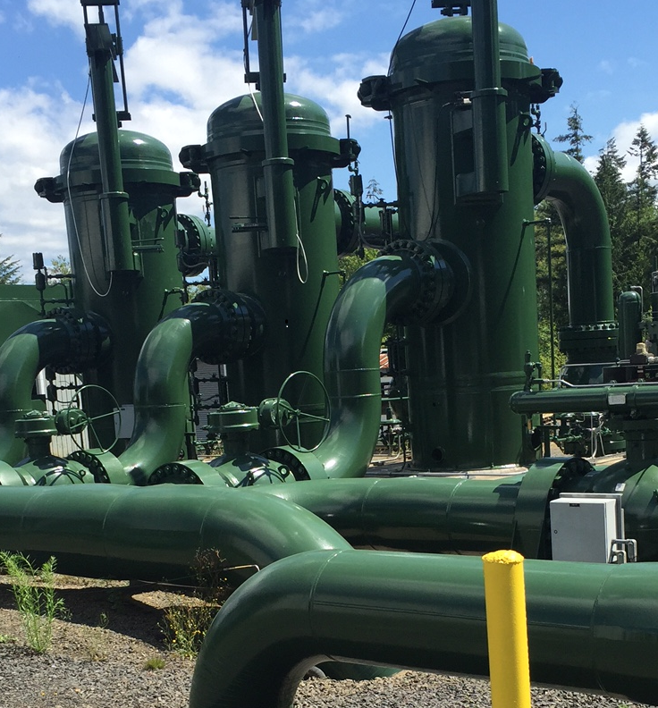
Elements of the Gas Supply Department
Buy and sell Gas
  Weather forecast, load forecast
  Gas commodity market
Schedule delivery through pipelines
Manage underground gas storage
  Procurement plan with Public Utility Commissions
Supply and asset planning
4

Slide 5
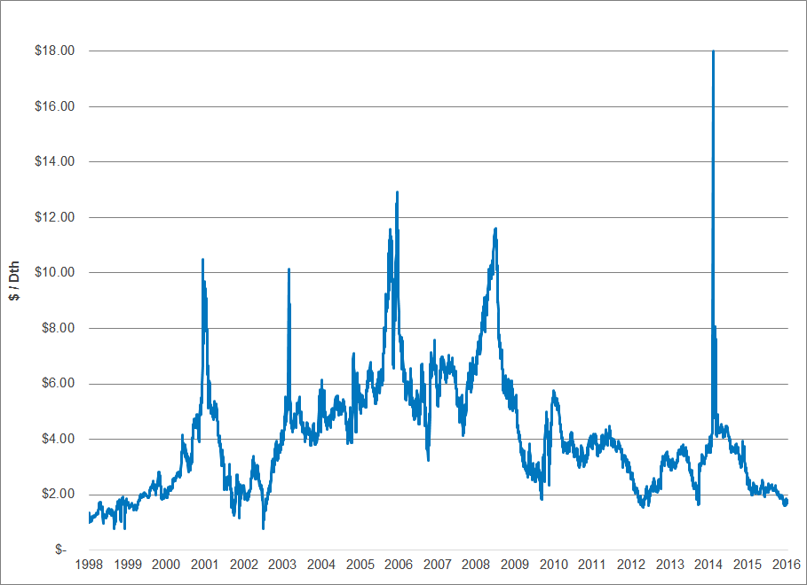
History of Gas Daily Spot Prices
Winter Weather Event
Hurricanes Rita and Katrina
Financial Crisis
Western Energy Crisis
Winter Weather Event
5
Priced at AECO

Slide 6
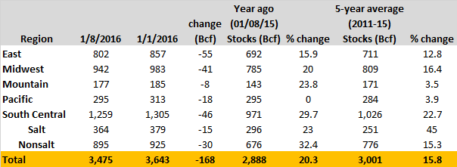
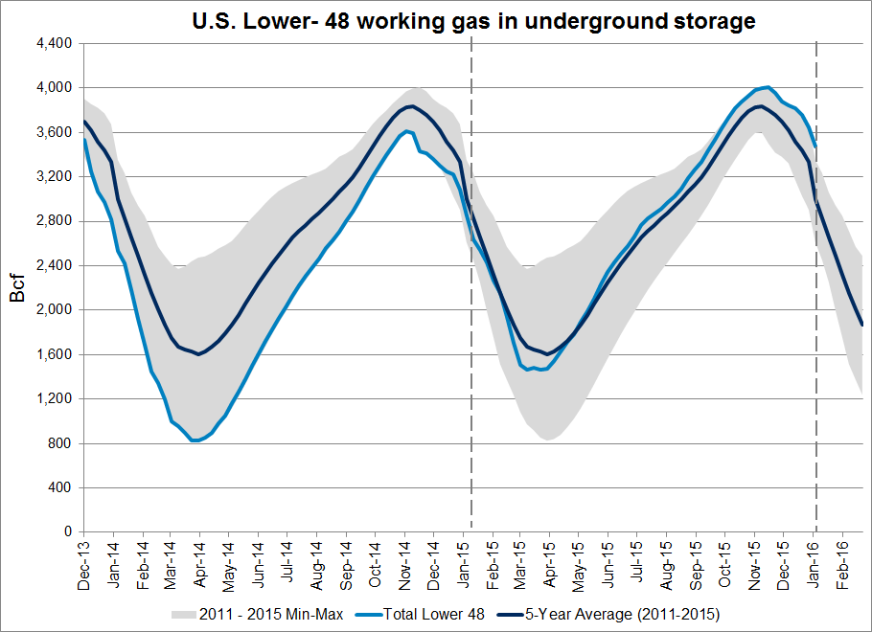
U.S. Storage Data
6
Notes:
Inject during times of price stability, withdraw in times of volatility.

Slide 7
Jackson Prairie Storage Project
Natural Gas Basins
NWP/Williams Pipeline
GTN /TransCanada Pipeline and other connecting pipelines
Vancouver
Jackson Prairie
Seattle
Portland
Spokane
Grants Pass; Medford
7

Slide 8
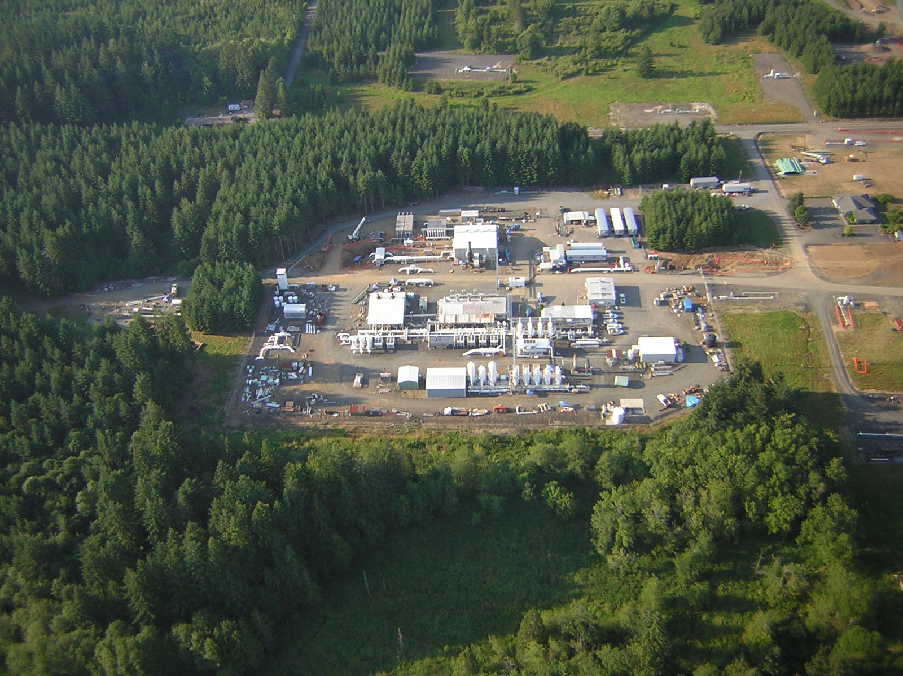
Aerial View of Jackson Prairie Compression and Processing Facility
8
* 10 miles south of Chehalis, WA

Slide 9
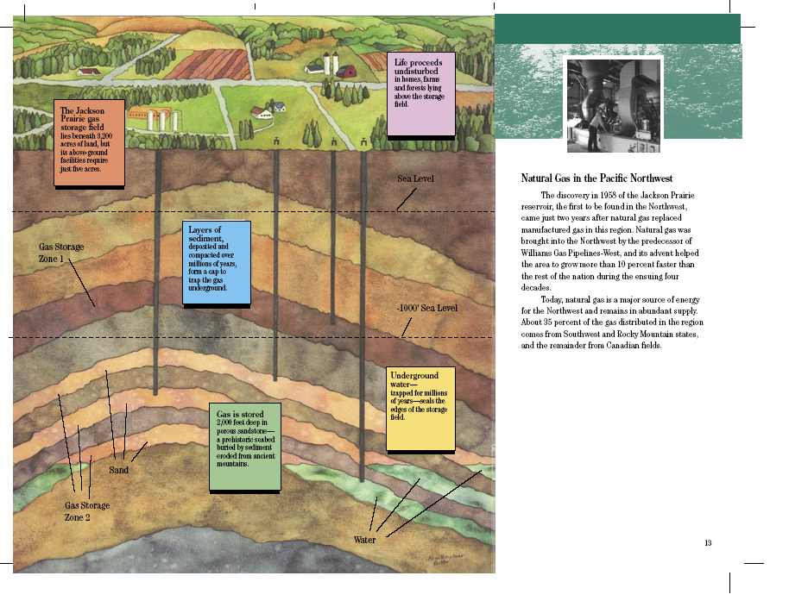
9

Slide 10
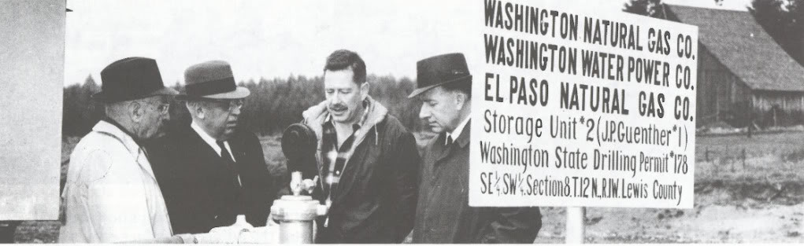
History of Jackson Prairie
1958
1962
1964
First exploration well was drilled, to a depth of 8,015 ft, by Continental Oil Company
Partnership formed by predecessors of Puget Sound Energy, Avista Corp, and Williams Gas Pipelines
First injection of gas
10
Notes:
The first exploration well was drilled in 1958, to a depth of 8015 ft, by Continental Oil Company, looking for Natural Gas (dry hole)
1962 a partnership was formed by the predecessors of Puget Sound Energy, Avista Corp, and Williams Gas Pipelines to explore storage possibilities
Gas was first injected in January of 1964
The Jackson Prairie Storage Project remains a partnership of the three companies and is operated by PSE

Slide 11
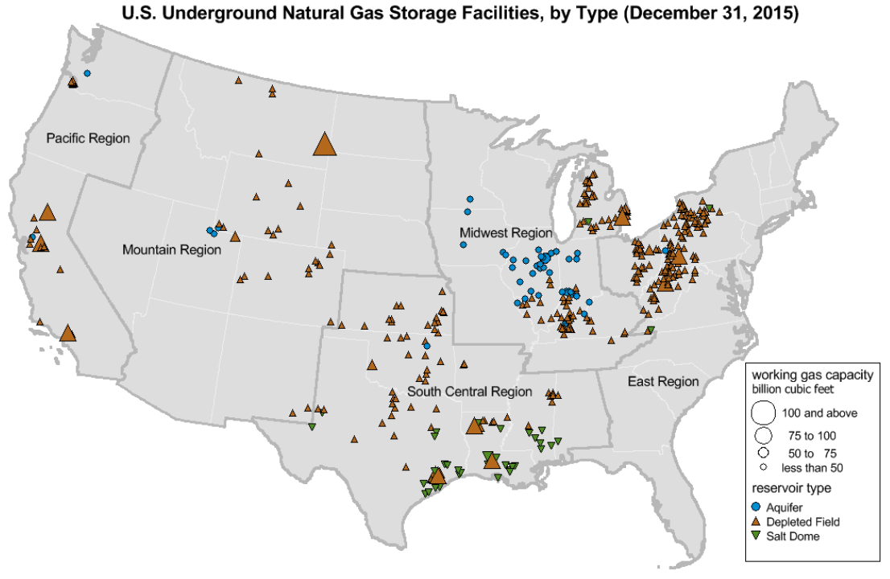
U.S. Storage Fields
11
Source: U.S. Energy Information Administration
Notes:
Source: EIA

Slide 12


Jackson Prairie Energy and Volume
Daily Energy: 1.2 Bcf/d = 1.2 trillion BTUs
10 coal trains with 100 - 50 ton cars each
29 - 500 MW gas fired electrical generation plants
15 large nuclear power plants
14 dams the size of Bonneville
Storage Volume: 45 billion cubic feet
12” pipeline 11,000,000 miles long (226,000 miles to the moon)
1,400 Safeco Stadiums
Average flow of the Columbia River for 2 days

Slide 13
Jackson Prairie - Benefits
The only storage facility in Washington State and one of two in the Pacific Northwest
JP prevents overbuilding of the pipeline system
JP is essential to the operation of the Williams Northwest Pipeline system by load balancing their pipeline and providing peaking services
Stores gas for more than a dozen different customers
JP is capable of supplying the needs of 2,000,000 homes on a cold winter day
JP supply: ~ 25% of the region's gas supply, 100% of Avista’s supply on a peak day, and 45% of PSE’s supply on a peak day

Slide 14
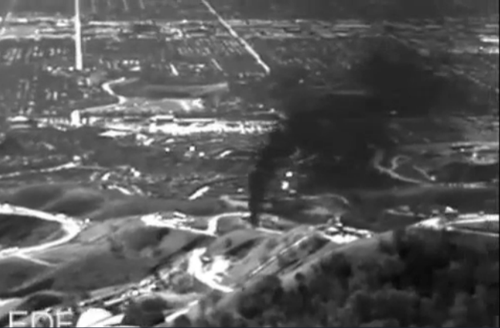
Aliso Canyon Storage
“The BP oil spill on land.”
-Erin Brockovich
Quick Facts
Owned by SoCal Gas
Adjacent to Porter Ranch community in Los Angeles
Well SS25 failed on 10/23/2015
Permanently sealed 2/17/2016
Value of lost gas approximately $10.8MM (30,000 Dth/day lost)
80,000 tons of methane released
4,400 households relocated
CPUC ordered withdrawals to cease; California State Senate passed moratorium on injections
Well permanently plugged
Well SS25 failed
LA sued SoCal
OCT 2015
NOV 2015
DEC 2015
JAN 2016
FEB 2016
Relief well drilling began
State of Emergency declared by Gov. Brown
Well controlled
14
Notes:
Porter Ranch Community in Los Angeles, population of 30,000
Aliso Canyon Well SS25 failed on 10/23/2015; SoCal reported after three days; failure expected to be ~1,000 feet deep
Lost an estimated 30,000 Dth/day
Sumas Generating Station daily consumption
Gas did not ignite; odorized, raw gas
Value of lost gas totaled $10.8 million
Has released more than 80,000 tons of methane into the atmosphere (daily emissions equivalent to 4 MM cars)
Timeline:
Well SS25 failed on 10/23/2015
Relief well drilling began 12/4/2015
LA sued SoCal on 12/7/2015
11 lawsuits or investigations by government entities currently in process; LA County filed criminal charges 2/2/2016 for not reporting the failure for 3 days – could be fined $25k/day
Environmentalists, notably Erin Brockovich, has called the leak the “BP oil spill on land”

Slide 15
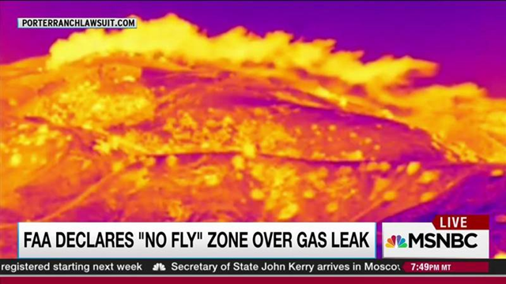
Porter Ranch Location
4.5
Miles*
15
* Distance from storage field to Cal State Northridge; less than a mile from Porter Ranch community (population 30,000)
Notes:
Porter Ranch Community in Los Angeles, population of 30,000 – more than 4,400 households relocated

Slide 16
Aerial View of Aliso Canyon Well Failure
Hole created by escaping gas
16

Slide 17
Aliso Canyon – Jackson Prairie Comparison
Comparison Criteria | Aliso Well | Jackson Prairie
Storage Reservoir Type | depleted oil field | salt water aquifer
Location Area | Populated | Rural
Gas Well | 111 | 55
Age of Field | Leaking well installed in 1953. 48 others installed prior to 1953. | oldest installed in 1964
Gas Reservoir Depth | 8,500' | 1,100' to 2,800'
Storage Volume (Bcf) | 86 Bcf | 46.9 Bcf
Average Flowrate (MMcf/d) | 60 MMcf/d | 40 to 60 MMcf/d
Reservoir Pressure (psig) | 2700 psig | 500 to 1,300 psig
Gas Odor (mercaptans) | odorized | none
Sub-surface Safety Valves | failed & removed in 1979 | none
Production Casing (inches) | 7" | 7" to 9.625"
Cathodically Protected Casings | Unknown but uncommon | Yes
Leak Detection History | Temperature and Pressure Surveys | Temperature and Pressure Surveys
17

Slide 18
Underground Gas Storage Regulations
JP is permitted and regulated by the Federal Energy Regulatory Commission (FERC)
Washington Department of Natural Resources (DNR) permits and regulates the natural gas wells at JP
JP’s pipelines and processing facilities are regulated by the Pipeline and Hazardous Materials Safety Administration (PHMSA) through Title 49 CFR Part 192
JP is closely following proposed regulatory changes, and discussing lessons learned at Aliso Canyon
State of California has introduced bills to:
  Protect consumers from cost
  Require all wells be inspected
  Require shut-off valves on wells
On February 5, 2016, PHMSA issued an advisory bulletin to voluntarily implement the American Petroleum Institute’s (API) Recommended Practices for Underground Storage (API RP-1171)
Sub-surface safety valves? (estimated $2B - $4B for 14,000 gas wells; $2B - $10B for new wells to replace lost deliverability)
Aliso Canyon is currently shut-in and working with regulatory officials to reopen. Company personnel are working with regulators to mitigate concerns of power and energy reliability should the project remain closed.
18
Notes:
JP is in full compliance with all applicable federal and state rules, laws and regulations

